Slide 1

Welcome to Amazon Web Services
Presented By :-
Er. Suryadev Chaudhary

Slide 2
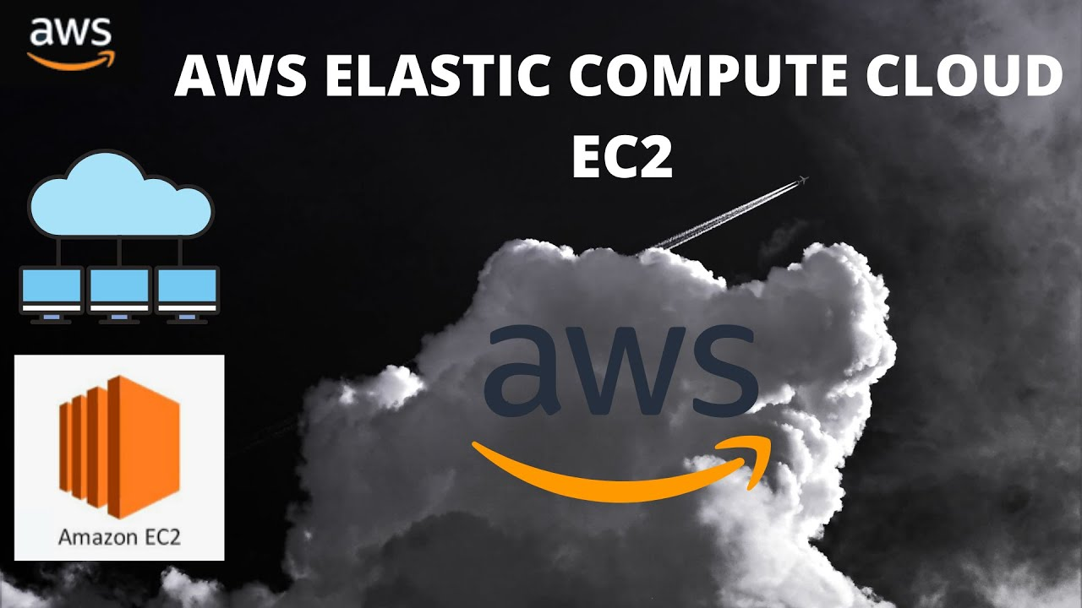
Elastic Compute Cloud (EC2 Service)

Slide 3
Elastic Compute Cloud (EC2)
Provides scalable computing capacity enables you to scale up or scale down the instance in the AWS cloud.
You can use Amazon EC2 to launch as many or as few as virtual servers as you need, configure security and networking and manage storage.
EC2 is having two storage options i.e. EBS and instance store.
By default when you create an EC2 account with amazon your account is limited to a maximum of 20 instances per EC2 region.

Slide 4
Features of amazon ec2
Instances
Amazon Machine Images (AMIs)
Instance types
Key pairs (AWS stores the public key, and you store the private key in a secure place)
Instance store volumes
Amazon Elastic Block Store (Amazon EBS)
Regions and Availability Zones
Security groups
Elastic IP addresses
Amazon EC2 resources
Virtual private clouds (VPCs)

Slide 5
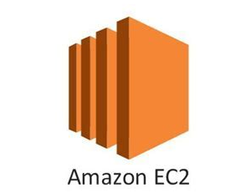
EC2 Instance
EC2 Instance is a virtual server in the Cloud.

Slide 6
AWS Region
Amazon EC2 is hosted in multiple locations world-wide. These locations are composed of AWS Regions, Availability Zones
Each Region is a separate geographic area.
Availability Zones are multiple, isolated locations within each Region.

Slide 7
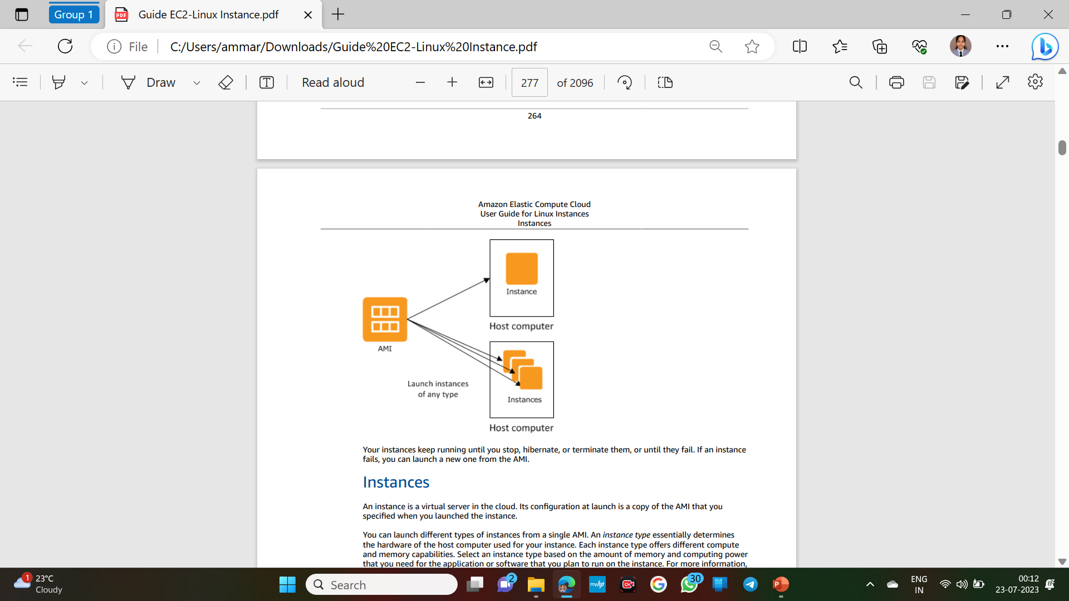
AMI Catalogs(Amazon Machine Image)
An AMI is a template that contains the software configuration (operating system, application server, and applications) required to launch your instance.

Slide 8
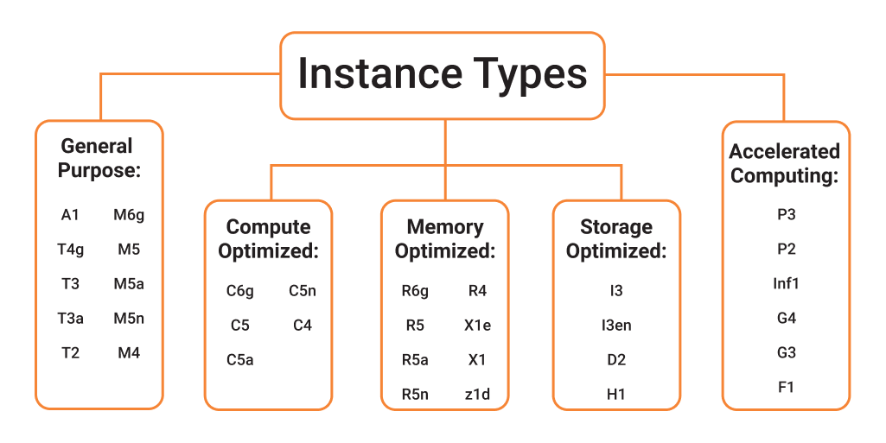
Instance Type
Selection of Instance Types mainly depends on the CPU and Memory
Instance Types is a wide selection of instance optimized to fit different use cases provided by the Amazon EC2
There are 5 Types of Instances

Slide 9

Key Pair
A key pair, consisting of a private key and a public key
It is a set of security credentials that you use to prove your identity when connecting to an instance.
The public key is saved by AWS to match it to the key pair name and private key when you try to login to the EC2 instances.
Without key pair you cannot access instances via RDP or SSH (Linux).

Slide 10
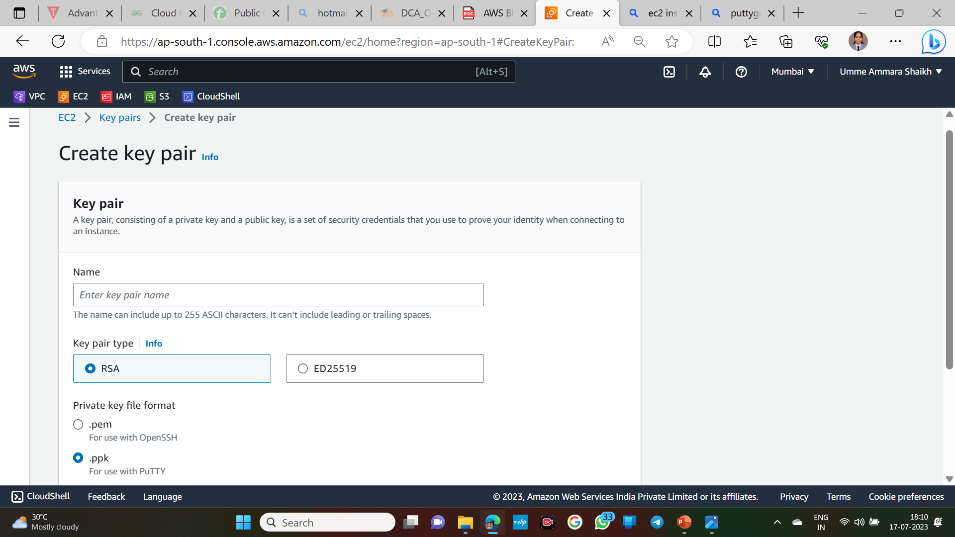

Slide 11
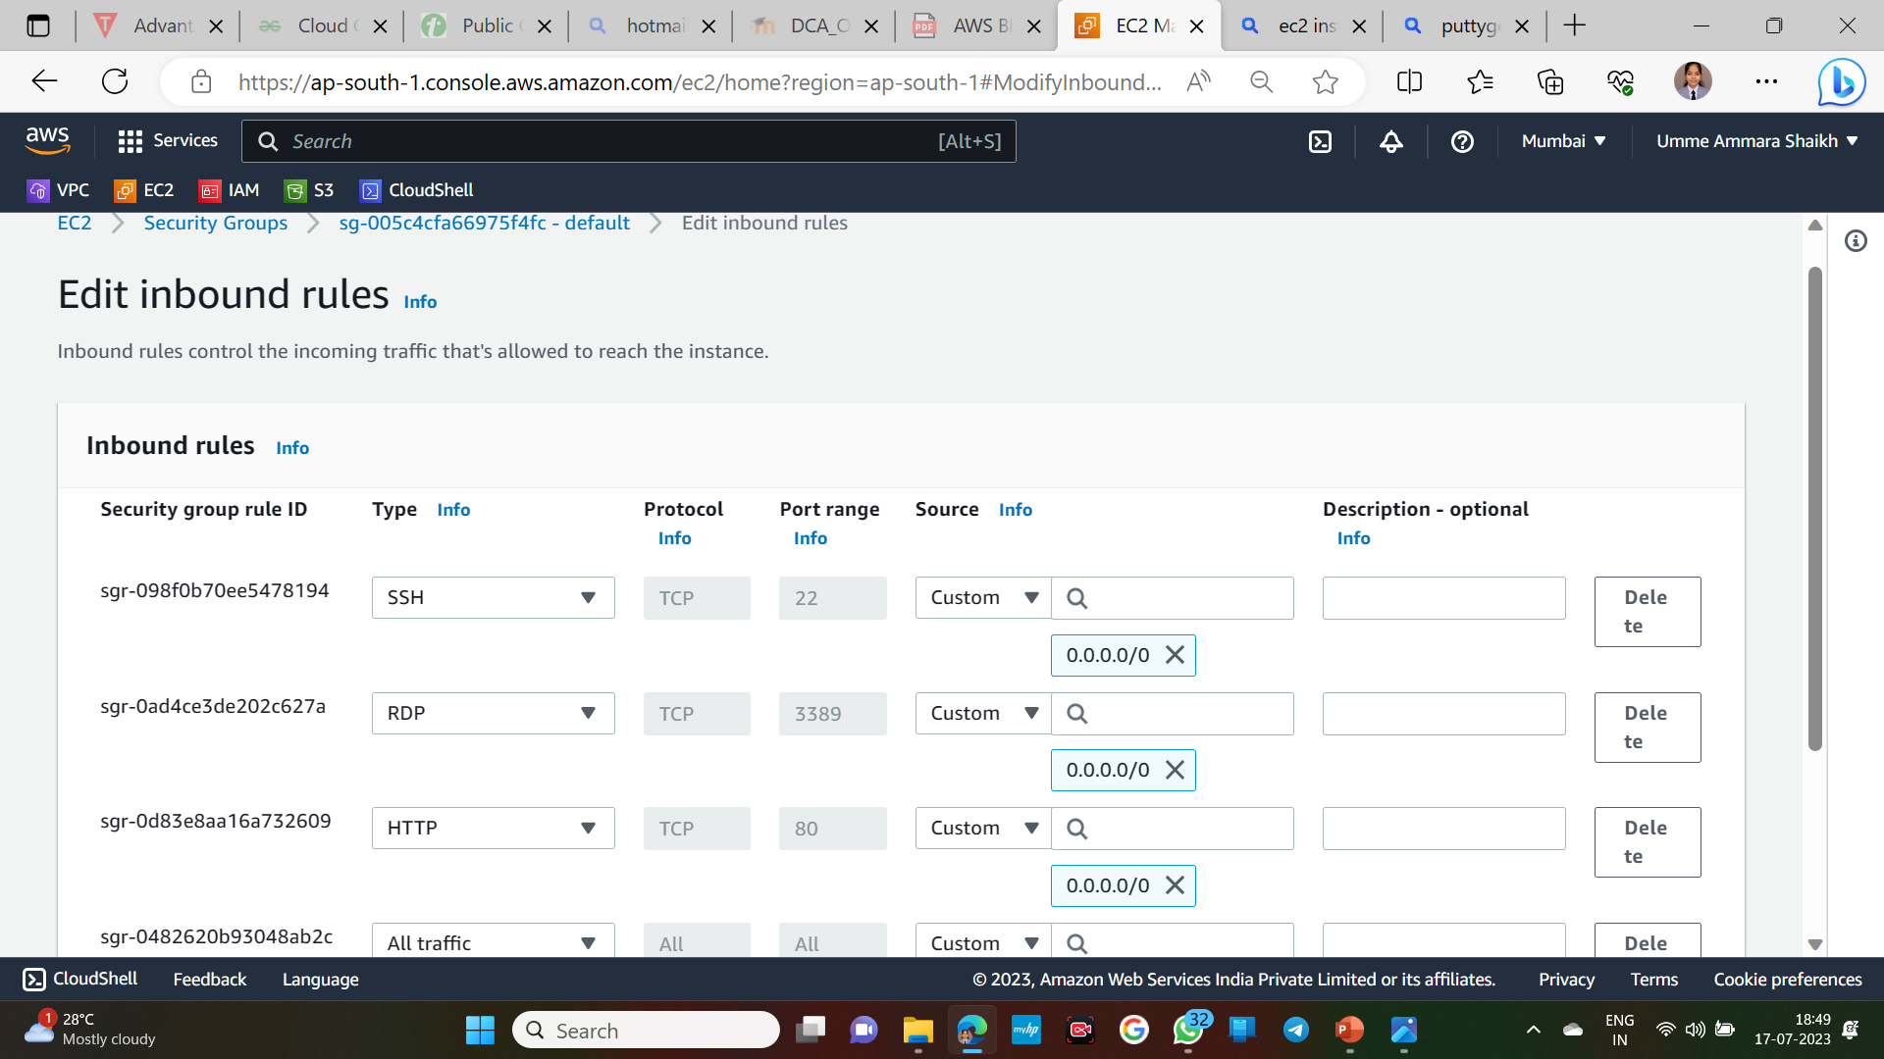
Security Group
A security group acts as a virtual firewall for your instance to control inbound and outbound traffic of the associated instance

Slide 12
EBS (Elastic Block Store)Volumes and Snapshot
EBS Volume is a durable, block-level storage device that you can attach to your instances and use as a physical hard drive
EBS volumes attached to a running instance are not deleted when instance is terminate but are detached with data interact
Snapshot is a backup of any EBS volume it write a copy of the data in the volume to Amazon S3, where it is stored redundantly in multiple Availability zones

Slide 13
The End
Thank You for Listening!

